Slide 1
GRUPO 9
TEMA: DATA WAREHOUSE
Giménez, Julián
Niro, José Alberto
Potenzo, Luís Marcelo
Rodríguez, Agustín
Veliz, Matías

Slide 2

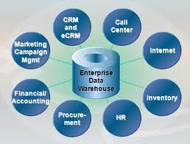
¿Qué es un Datawarehouse?
“Es un repositorio de datos integrado, no volátil, variable en el tiempo, orientado al negocio, singular en toda la compañía, organizado de forma tal que facilita el análisis de grandes volúmenes de datos para la toma de decisiones (Decada 80’)”
OLTP -> OLAP
_{<number>}
Notes:
Sources:
The Guardian, May 2010
IDC Digital Universe, 2010
IBM Institute for Business Value, 2009
IBM CIO Study 2010
TDWI: Next Generation Data Warehouse Platforms Q4 2009
Summary
Data is exploding – in volume, variety and velocity. And both struc and unstruc info will continue to grow at astronomical rates.
This creates a tremendous opportunity for organizations to make timely decisions and achieve business goals.
However, at the same time, organizations are struggling to gain deeper insights from this data. Business leaders continue to make decisions without access to the trusted information they need.
CEOs understand that they need to do a better job in capturing and understanding information

Slide 3
Caracteristicas
Integrado
•Información proveniente de sistemas heterogéneos. (BD, excels, archivos planos, CRM, ERP, etc.)
•Procesos de integración de datos y limpieza de información. (unificación de formatos, códigos, etc.)
No volátil
•Los datos perduran en el tiempo. Sólo inserts y updates.
Variable en el tiempo
•Es un repositorio de datos históricos.
•El tiempo de conservación de los datos es mayor que en sistemas transaccionales.
•La fecha es un dato fundamental, para poder analizar en el tiempo.
Orientado al negocio
•Los datos están organizados y presentados como se manejan en el negocio.
•Los datos tienen el nivel de detalle y estructura necesarios para los que toman decisiones.
_{<number>}
Notes:
Sources:
The Guardian, May 2010
IDC Digital Universe, 2010
IBM Institute for Business Value, 2009
IBM CIO Study 2010
TDWI: Next Generation Data Warehouse Platforms Q4 2009
Summary
Data is exploding – in volume, variety and velocity. And both struc and unstruc info will continue to grow at astronomical rates.
This creates a tremendous opportunity for organizations to make timely decisions and achieve business goals.
However, at the same time, organizations are struggling to gain deeper insights from this data. Business leaders continue to make decisions without access to the trusted information they need.
CEOs understand that they need to do a better job in capturing and understanding information

Slide 4
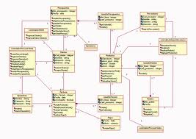
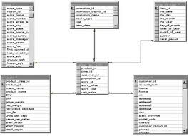
Definiciones
Sistemas OLTP (On Line Transactional Process)
Sistemas preparados para realizar transacciones en tiempo real (altas, bajas, modificaciones y procesos instantáneos).
Sistemas OLAP (On Line Analitical Process)
Sistemas preparados para atender consultas complejas y de grandes volúmenes de datos.
_{<number>}
Notes:
Sources:
The Guardian, May 2010
IDC Digital Universe, 2010
IBM Institute for Business Value, 2009
IBM CIO Study 2010
TDWI: Next Generation Data Warehouse Platforms Q4 2009
Summary
Data is exploding – in volume, variety and velocity. And both struc and unstruc info will continue to grow at astronomical rates.
This creates a tremendous opportunity for organizations to make timely decisions and achieve business goals.
However, at the same time, organizations are struggling to gain deeper insights from this data. Business leaders continue to make decisions without access to the trusted information they need.
CEOs understand that they need to do a better job in capturing and understanding information

Slide 5
OLTP vs OLAP
 | OLTP | OLAP
Application | Operational: ERP, CRM, legacy apps, ... | Management Information System, Decision Support System
Typical users | Staff | Managers, Executives
Horizon | Weeks, Months | Years
Refresh | Immediate | Periodic
Data model | Entity-relationship | Multi-dimensional
Schema | Normalized | Star/ Snowflakes
Emphasis | Update | Retrieval
Volume | Low | Massive
_{<number>}
Notes:
Sources:
The Guardian, May 2010
IDC Digital Universe, 2010
IBM Institute for Business Value, 2009
IBM CIO Study 2010
TDWI: Next Generation Data Warehouse Platforms Q4 2009
Summary
Data is exploding – in volume, variety and velocity. And both struc and unstruc info will continue to grow at astronomical rates.
This creates a tremendous opportunity for organizations to make timely decisions and achieve business goals.
However, at the same time, organizations are struggling to gain deeper insights from this data. Business leaders continue to make decisions without access to the trusted information they need.
CEOs understand that they need to do a better job in capturing and understanding information

Slide 6
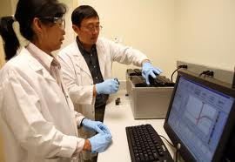
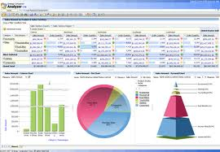
Real Time Vs Batch
Procesamiento en tiempo real - OLTP
Existe un proceso de entrada y salida continua de datos. Un puñado de datos tienen que ser procesados ​​en un período de tiempo pequeño estipulado (tiempo real), de lo contrario crearía problemas para el sistema.
Por ejemplo: robots de montaje de la línea, sistema de radar.
Procesamiento Batch - OLAP
Se conoce como sistema por lotes, a la ejecución de un programa sin el control o supervisión directa del usuario, el cual puede ser scheduleado y generalmente soporta grandes volúmenes de datos.
Por ejemplo: Datawarehouse
_{<number>}
Notes:
Sources:
The Guardian, May 2010
IDC Digital Universe, 2010
IBM Institute for Business Value, 2009
IBM CIO Study 2010
TDWI: Next Generation Data Warehouse Platforms Q4 2009
Summary
Data is exploding – in volume, variety and velocity. And both struc and unstruc info will continue to grow at astronomical rates.
This creates a tremendous opportunity for organizations to make timely decisions and achieve business goals.
However, at the same time, organizations are struggling to gain deeper insights from this data. Business leaders continue to make decisions without access to the trusted information they need.
CEOs understand that they need to do a better job in capturing and understanding information

Slide 7
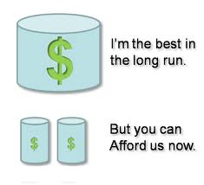
Datawarehouse vs Datamart
Un Datamart está orientado a una temática, repositorio de datos diseñado para responder especificas peticiones de usuarios puntuales.
_{<number>}
Notes:
Sources:
The Guardian, May 2010
IDC Digital Universe, 2010
IBM Institute for Business Value, 2009
IBM CIO Study 2010
TDWI: Next Generation Data Warehouse Platforms Q4 2009
Summary
Data is exploding – in volume, variety and velocity. And both struc and unstruc info will continue to grow at astronomical rates.
This creates a tremendous opportunity for organizations to make timely decisions and achieve business goals.
However, at the same time, organizations are struggling to gain deeper insights from this data. Business leaders continue to make decisions without access to the trusted information they need.
CEOs understand that they need to do a better job in capturing and understanding information

Slide 8

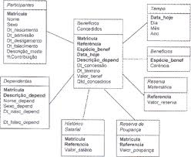
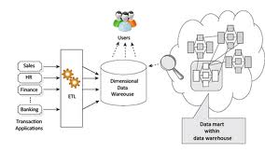
Debate Kimball - Inmon
Kimball
Datamart es un modelo dimensional de datos departamentales y que el DW es la colección de los DM relacionados por un BUS central.
Bottom - Up
Implementación
escalable
Pueden existir
inconsistencias al integrar
Dimensional
Modeling
_{<number>}
Notes:
Sources:
The Guardian, May 2010
IDC Digital Universe, 2010
IBM Institute for Business Value, 2009
IBM CIO Study 2010
TDWI: Next Generation Data Warehouse Platforms Q4 2009
Summary
Data is exploding – in volume, variety and velocity. And both struc and unstruc info will continue to grow at astronomical rates.
This creates a tremendous opportunity for organizations to make timely decisions and achieve business goals.
However, at the same time, organizations are struggling to gain deeper insights from this data. Business leaders continue to make decisions without access to the trusted information they need.
CEOs understand that they need to do a better job in capturing and understanding information

Slide 9

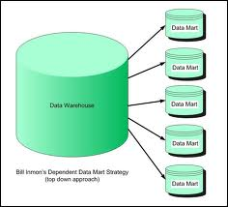
Debate Kimball - Inmon
Inmon
Conformación de un repositorio central con las distintas fuentes(relacional), donde una vez conformado desde una baja granularidad, se podría extraer información para cada área particular.
Top - Down
Mayor consistencia
de los datos
Mas costoso
_{<number>}
Notes:
Sources:
The Guardian, May 2010
IDC Digital Universe, 2010
IBM Institute for Business Value, 2009
IBM CIO Study 2010
TDWI: Next Generation Data Warehouse Platforms Q4 2009
Summary
Data is exploding – in volume, variety and velocity. And both struc and unstruc info will continue to grow at astronomical rates.
This creates a tremendous opportunity for organizations to make timely decisions and achieve business goals.
However, at the same time, organizations are struggling to gain deeper insights from this data. Business leaders continue to make decisions without access to the trusted information they need.
CEOs understand that they need to do a better job in capturing and understanding information

Slide 10
Herramientas ETL
Front
End OP
Sistemas Operacionales
ARQUITECTURA BUSINESS INTELLIGENCE
Front End
BI
Batch
Near Real-Time
Oracle
Balance
Scorecard
DWH
SQL Server
Extracción
Data
Mining
Archivos
Planos
Transformación
Limpieza
OLAP
Analitical
Canales de Atención
DB2
Carga (L)
Web Services
ETL
Ad-Hoc
Query
Otros
Data
Profiling
Reporting
TÉCNICA METADATOS CORPORATIVOS NEGOCIO
Metadata Operacional Metadata de Negocio
_{<number>}
Notes:
Sources:
The Guardian, May 2010
IDC Digital Universe, 2010
IBM Institute for Business Value, 2009
IBM CIO Study 2010
TDWI: Next Generation Data Warehouse Platforms Q4 2009
Summary
Data is exploding – in volume, variety and velocity. And both struc and unstruc info will continue to grow at astronomical rates.
This creates a tremendous opportunity for organizations to make timely decisions and achieve business goals.
However, at the same time, organizations are struggling to gain deeper insights from this data. Business leaders continue to make decisions without access to the trusted information they need.
CEOs understand that they need to do a better job in capturing and understanding information

Slide 11
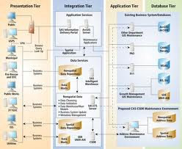
ETL - Definición
Un sistema de ETL bien diseñado extrae datos de varios
orígenes, focalizando sus esfuerzos en la calidad,
consistencia, normalización, creación y distribución de
datos.
_{<number>}
Notes:
Sources:
The Guardian, May 2010
IDC Digital Universe, 2010
IBM Institute for Business Value, 2009
IBM CIO Study 2010
TDWI: Next Generation Data Warehouse Platforms Q4 2009
Summary
Data is exploding – in volume, variety and velocity. And both struc and unstruc info will continue to grow at astronomical rates.
This creates a tremendous opportunity for organizations to make timely decisions and achieve business goals.
However, at the same time, organizations are struggling to gain deeper insights from this data. Business leaders continue to make decisions without access to the trusted information they need.
CEOs understand that they need to do a better job in capturing and understanding information

Slide 12
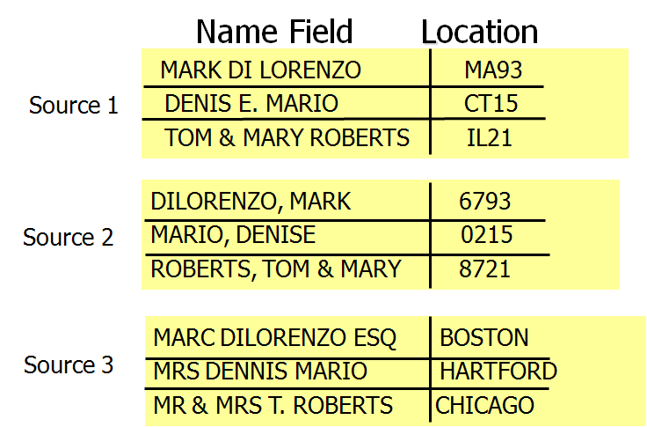
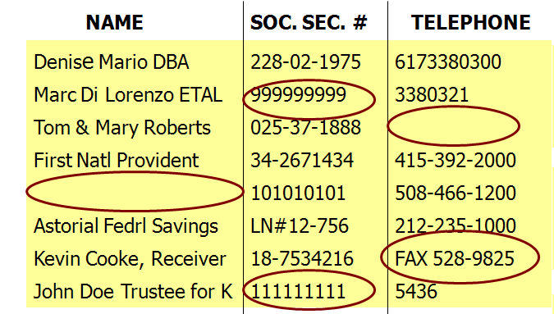
El Sistema ETL
Elimina errores y corrige fallas de datos
Proporciona medidas documentadas para la confianza de los datos
Captura el flujo de los datos transaccionales para su custodia
Ajusta datos de múltiples fuentes para ser usada como una única fuente
Crea y mantiene estructuras de datos que puedan ser usadas por herramientas para los usuarios finales
_{<number>}
Notes:
Sources:
The Guardian, May 2010
IDC Digital Universe, 2010
IBM Institute for Business Value, 2009
IBM CIO Study 2010
TDWI: Next Generation Data Warehouse Platforms Q4 2009
Summary
Data is exploding – in volume, variety and velocity. And both struc and unstruc info will continue to grow at astronomical rates.
This creates a tremendous opportunity for organizations to make timely decisions and achieve business goals.
However, at the same time, organizations are struggling to gain deeper insights from this data. Business leaders continue to make decisions without access to the trusted information they need.
CEOs understand that they need to do a better job in capturing and understanding information

Slide 13
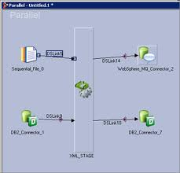
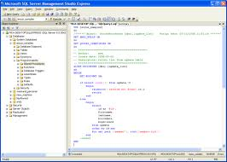
¿Qué elegir?
Construir el proceso de carga con una herramienta de ETL
Codificar el ETL
_{<number>}
Notes:
Sources:
The Guardian, May 2010
IDC Digital Universe, 2010
IBM Institute for Business Value, 2009
IBM CIO Study 2010
TDWI: Next Generation Data Warehouse Platforms Q4 2009
Summary
Data is exploding – in volume, variety and velocity. And both struc and unstruc info will continue to grow at astronomical rates.
This creates a tremendous opportunity for organizations to make timely decisions and achieve business goals.
However, at the same time, organizations are struggling to gain deeper insights from this data. Business leaders continue to make decisions without access to the trusted information they need.
CEOs understand that they need to do a better job in capturing and understanding information

Slide 14
Herramienta ETL versus Codificar
Herramienta ETL | HandCode
Construcción mas simple y rápida. | Las rutinas heredadas de los sistemas legacy problablemente puedan dejarse como están.
Independencia del programador | Los desarrolladores pueden estar disponibles.
Metadata (auto documentación) | ?
Conectores nativos | -
Análisis de impacto | -
Consola de Operaciones para monitoreo de Procesos y recursos. | -
Escalabilidad (Balanceo de carga) | ?
TCO mas bajo | Mucho mas económico para una solución de paso.
Alta performance | ?
_{<number>}
Notes:
Sources:
The Guardian, May 2010
IDC Digital Universe, 2010
IBM Institute for Business Value, 2009
IBM CIO Study 2010
TDWI: Next Generation Data Warehouse Platforms Q4 2009
Summary
Data is exploding – in volume, variety and velocity. And both struc and unstruc info will continue to grow at astronomical rates.
This creates a tremendous opportunity for organizations to make timely decisions and achieve business goals.
However, at the same time, organizations are struggling to gain deeper insights from this data. Business leaders continue to make decisions without access to the trusted information they need.
CEOs understand that they need to do a better job in capturing and understanding information

Slide 15
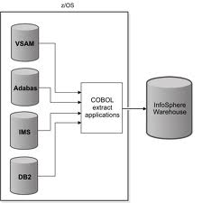
Flujo datos - Extracción
Extracción:
(Requirements/Realities ➔ Architecture ➔ Implementation ➔ Test/Release)
Data Flow: Extract ➔ Clean ➔ Conform ➔ Deliver
ODBC
Mainframe
Cobol
EBCDIC to ASCII
Numeric Data
Pictures
Dates
Web Logs Sources
XML
TXT
DBs
ERPs…
_{<number>}
Notes:
Sources:
The Guardian, May 2010
IDC Digital Universe, 2010
IBM Institute for Business Value, 2009
IBM CIO Study 2010
TDWI: Next Generation Data Warehouse Platforms Q4 2009
Summary
Data is exploding – in volume, variety and velocity. And both struc and unstruc info will continue to grow at astronomical rates.
This creates a tremendous opportunity for organizations to make timely decisions and achieve business goals.
However, at the same time, organizations are struggling to gain deeper insights from this data. Business leaders continue to make decisions without access to the trusted information they need.
CEOs understand that they need to do a better job in capturing and understanding information

Slide 16
Fuentes de datos
OLTP
ERP – Planificacion de los recursos empresariales
SAP, J&D Edwards…
CRM – gestión de las relaciones con los clientes,
a la venta y al marketing
SIEBEL, SAP CRM
Sistemas Legacy– sistemas heredados que se mantienen con el tiempo
dado su alto costo de migracion
AS400, Sistema a medida sin mantenimiento
WEB Services– Utiliza conjunto de protocolos y estándares que sirven para
intercambiar datos entre aplicaciones.
Bloomberg Service, Bank Service
Otros – Flat Files, Planillas de calculo, XML,…
_{<number>}
Notes:
Sources:
The Guardian, May 2010
IDC Digital Universe, 2010
IBM Institute for Business Value, 2009
IBM CIO Study 2010
TDWI: Next Generation Data Warehouse Platforms Q4 2009
Summary
Data is exploding – in volume, variety and velocity. And both struc and unstruc info will continue to grow at astronomical rates.
This creates a tremendous opportunity for organizations to make timely decisions and achieve business goals.
However, at the same time, organizations are struggling to gain deeper insights from this data. Business leaders continue to make decisions without access to the trusted information they need.
CEOs understand that they need to do a better job in capturing and understanding information

Slide 17
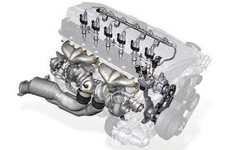
Flujo datos – Limpieza y Conformación
Extracción:
(Requirements/Realities ➔ Architecture ➔ Implementation ➔ Test/Release)
Data Flow: Extract ➔ Clean ➔ Conform ➔ Deliver
+ VALOR
Definiendo Data Quality
Correctos
No ambiguos
Consistentes
Completos
_{<number>}
Notes:
Sources:
The Guardian, May 2010
IDC Digital Universe, 2010
IBM Institute for Business Value, 2009
IBM CIO Study 2010
TDWI: Next Generation Data Warehouse Platforms Q4 2009
Summary
Data is exploding – in volume, variety and velocity. And both struc and unstruc info will continue to grow at astronomical rates.
This creates a tremendous opportunity for organizations to make timely decisions and achieve business goals.
However, at the same time, organizations are struggling to gain deeper insights from this data. Business leaders continue to make decisions without access to the trusted information they need.
CEOs understand that they need to do a better job in capturing and understanding information

Slide 18
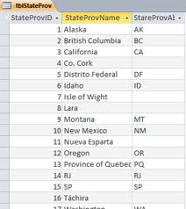
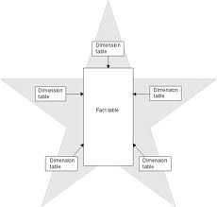
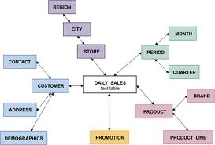
Flujo datos – Entrega
Extracción:
(Requirements/Realities ➔ Architecture ➔ Implementation ➔ Test/Release)
Data Flow: Extract ➔ Clean ➔ Conform ➔ Deliver
Carga de Modelo relacional
Integracion de las fuentes, modelado pseudo warehousing.
Carga de Dimensiones
Es una colección de datos orientada a un determinado ámbito (empresa, organización, etc.)
Carga de las Fact Tables
Tabla central de un esquema dimensional y contiene los valores de las medidas de negocio.
_{<number>}
Notes:
Sources:
The Guardian, May 2010
IDC Digital Universe, 2010
IBM Institute for Business Value, 2009
IBM CIO Study 2010
TDWI: Next Generation Data Warehouse Platforms Q4 2009
Summary
Data is exploding – in volume, variety and velocity. And both struc and unstruc info will continue to grow at astronomical rates.
This creates a tremendous opportunity for organizations to make timely decisions and achieve business goals.
However, at the same time, organizations are struggling to gain deeper insights from this data. Business leaders continue to make decisions without access to the trusted information they need.
CEOs understand that they need to do a better job in capturing and understanding information

Slide 19


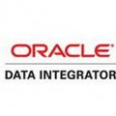
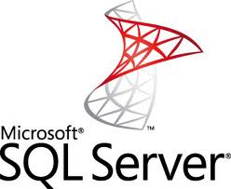


Herramientas ETL mercado
Notes:
Sources:
The Guardian, May 2010
IDC Digital Universe, 2010
IBM Institute for Business Value, 2009
IBM CIO Study 2010
TDWI: Next Generation Data Warehouse Platforms Q4 2009
Summary
Data is exploding – in volume, variety and velocity. And both struc and unstruc info will continue to grow at astronomical rates.
This creates a tremendous opportunity for organizations to make timely decisions and achieve business goals.
However, at the same time, organizations are struggling to gain deeper insights from this data. Business leaders continue to make decisions without access to the trusted information they need.
CEOs understand that they need to do a better job in capturing and understanding information

Slide 20
Explotación de datos
Front
End OP
Sistemas Operacionales
ARQUITECTURA BUSINESS INTELLIGENCE
Front End
BI
Batch
Near Real-Time
Oracle
Balance
Scorecard
DWH
SQL Server
Extracción
Data
Mining
Archivos
Planos
Transformación
Canales de Atención
Limpieza
OLAP
Analitical
DB2
Carga (L)
Web Services
ETL
Ad-Hoc
Query
Otros
Data
Profiling
Reporting
TÉCNICA METADATOS CORPORATIVOS NEGOCIO
Metadata Operacional Metadata de Negocio
_{<number>}
Notes:
Sources:
The Guardian, May 2010
IDC Digital Universe, 2010
IBM Institute for Business Value, 2009
IBM CIO Study 2010
TDWI: Next Generation Data Warehouse Platforms Q4 2009
Summary
Data is exploding – in volume, variety and velocity. And both struc and unstruc info will continue to grow at astronomical rates.
This creates a tremendous opportunity for organizations to make timely decisions and achieve business goals.
However, at the same time, organizations are struggling to gain deeper insights from this data. Business leaders continue to make decisions without access to the trusted information they need.
CEOs understand that they need to do a better job in capturing and understanding information

Slide 21
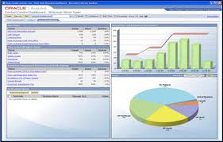

Explotación de datos
Warehouse no es un fin en si mismo, sino un medio para solucionar una necesidad: el análisis de información y la toma de decisiones
¿Cómo?
Explotación de datos
Punto de contacto directo con el usuario final
Notes:
Sources:
The Guardian, May 2010
IDC Digital Universe, 2010
IBM Institute for Business Value, 2009
IBM CIO Study 2010
TDWI: Next Generation Data Warehouse Platforms Q4 2009
Summary
Data is exploding – in volume, variety and velocity. And both struc and unstruc info will continue to grow at astronomical rates.
This creates a tremendous opportunity for organizations to make timely decisions and achieve business goals.
However, at the same time, organizations are struggling to gain deeper insights from this data. Business leaders continue to make decisions without access to the trusted information they need.
CEOs understand that they need to do a better job in capturing and understanding information

Slide 22
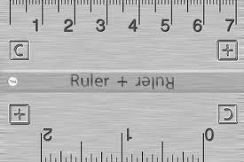
Explotación de datos
¿Que es Medir ?
“Es determinar la dimensión de la magnitud de una variable, en relación con una unidad de medida preestablecida y convencional”
¿Para que Medir ?
“Para establecer la comparación entre elementos que poseen la misma característica”
¿Cómo Medir ?
“Se utiliza una elemento/artefacto de comparación preestablecido con antelación, y que se mantiene inalterable en el tiempo”
_{<number>}
Notes:
Sources:
The Guardian, May 2010
IDC Digital Universe, 2010
IBM Institute for Business Value, 2009
IBM CIO Study 2010
TDWI: Next Generation Data Warehouse Platforms Q4 2009
Summary
Data is exploding – in volume, variety and velocity. And both struc and unstruc info will continue to grow at astronomical rates.
This creates a tremendous opportunity for organizations to make timely decisions and achieve business goals.
However, at the same time, organizations are struggling to gain deeper insights from this data. Business leaders continue to make decisions without access to the trusted information they need.
CEOs understand that they need to do a better job in capturing and understanding information

Slide 23
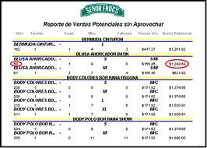
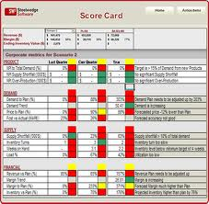
Tipos de informes
El reporte es aquel documento que se utilizará cuando se quiera informar o dar noticia acerca de una determinada cuestión
Reportes simples
Importes y agrupadores seleccionados con formato
Reportes sabana
Importes y agrupadores sin formato, a granel.
Dashboards
Es un conjunto indicadores y gráficos que permiten obtener de un rápido vistazo información clave
Scorecards
Mas formal que el Dashboard y tiene un formato standard.
Notes:
Sources:
The Guardian, May 2010
IDC Digital Universe, 2010
IBM Institute for Business Value, 2009
IBM CIO Study 2010
TDWI: Next Generation Data Warehouse Platforms Q4 2009
Summary
Data is exploding – in volume, variety and velocity. And both struc and unstruc info will continue to grow at astronomical rates.
This creates a tremendous opportunity for organizations to make timely decisions and achieve business goals.
However, at the same time, organizations are struggling to gain deeper insights from this data. Business leaders continue to make decisions without access to the trusted information they need.
CEOs understand that they need to do a better job in capturing and understanding information

Slide 24
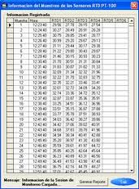
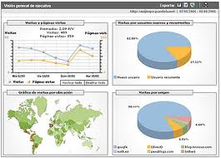
Tipos de informes
Antes
Reportes grilla (sabana), excesiva información, sin formato, estaticos, dificil de leer…, (operativos)
Ahora
Gráficos, concisos, dinámicos, colaborativos, compartibles, indicadores
de clave. Objetivo ver la compañía en un golpe de vista(Gerenciales)
Podemos almacenar sólo de tres y hasta nueve trozos de información visual en nuestra memoria y por un breve lapso de tiempo”
Notes:
Sources:
The Guardian, May 2010
IDC Digital Universe, 2010
IBM Institute for Business Value, 2009
IBM CIO Study 2010
TDWI: Next Generation Data Warehouse Platforms Q4 2009
Summary
Data is exploding – in volume, variety and velocity. And both struc and unstruc info will continue to grow at astronomical rates.
This creates a tremendous opportunity for organizations to make timely decisions and achieve business goals.
However, at the same time, organizations are struggling to gain deeper insights from this data. Business leaders continue to make decisions without access to the trusted information they need.
CEOs understand that they need to do a better job in capturing and understanding information

Slide 25
Ejemplos típicos de reportes corporativos
•Ventas (Reservas, Facturación, Cantidad de Ordenes, Precio de Venta, etc.)
•Marketing (Cuota de Mercado, Campañas realizadas, Clientes, etc.)
•Finanzas (Ingresos, Costos, Margen Bruto, etc.)
•Soporte (Número de llamados, Casos Resueltos, Satisfacción del Cliente, etc.)
•Producción(Cantidad Producida, Tiempo de Producción, Cantidad de Defectos, etc.)
•Recursos Humanos(Satisfacción del Empleado, Rotación de Personal, Cantidad de Posiciones abiertas, etc.)
•IT (Caída de Red, Tiempo de Uso del Sistema, Errores Corregidos, Líneas de códigos realizadas, etc.).
•Web(Cantidad de Visitas, Cantidad de Paginas accedidas, Duración de la navegación, etc.)
Notes:
Sources:
The Guardian, May 2010
IDC Digital Universe, 2010
IBM Institute for Business Value, 2009
IBM CIO Study 2010
TDWI: Next Generation Data Warehouse Platforms Q4 2009
Summary
Data is exploding – in volume, variety and velocity. And both struc and unstruc info will continue to grow at astronomical rates.
This creates a tremendous opportunity for organizations to make timely decisions and achieve business goals.
However, at the same time, organizations are struggling to gain deeper insights from this data. Business leaders continue to make decisions without access to the trusted information they need.
CEOs understand that they need to do a better job in capturing and understanding information

Slide 26
Ejemplos típicos de reportes corporativos
Acumulativas
•YTD(Year to Date): Acumulado Anual
•MTD(Month to Date): Acumulado mensual
•WTD(Week to Date): Acumulado Semanal
•TSF(Today so Far): Acumulado diario
Comparativas
•Mes Anterior
•Mismo Mes Año Anterior
•Día Anterior
•Día Mes Anterior
•Día Laboral Mes Anterior
Notes:
Sources:
The Guardian, May 2010
IDC Digital Universe, 2010
IBM Institute for Business Value, 2009
IBM CIO Study 2010
TDWI: Next Generation Data Warehouse Platforms Q4 2009
Summary
Data is exploding – in volume, variety and velocity. And both struc and unstruc info will continue to grow at astronomical rates.
This creates a tremendous opportunity for organizations to make timely decisions and achieve business goals.
However, at the same time, organizations are struggling to gain deeper insights from this data. Business leaders continue to make decisions without access to the trusted information they need.
CEOs understand that they need to do a better job in capturing and understanding information

Slide 27







Herramientas Explotación de datos (BI) del mercado
Notes:
Sources:
The Guardian, May 2010
IDC Digital Universe, 2010
IBM Institute for Business Value, 2009
IBM CIO Study 2010
TDWI: Next Generation Data Warehouse Platforms Q4 2009
Summary
Data is exploding – in volume, variety and velocity. And both struc and unstruc info will continue to grow at astronomical rates.
This creates a tremendous opportunity for organizations to make timely decisions and achieve business goals.
However, at the same time, organizations are struggling to gain deeper insights from this data. Business leaders continue to make decisions without access to the trusted information they need.
CEOs understand that they need to do a better job in capturing and understanding information

Slide 28
¡MUCHAS GRACIAS!

